Slide 1

Computer Networks
2022-23 Semester:III
School of Computer Engineering and Technology (SCET)

Slide 2

Computer Networks
Teaching Scheme Credits: 3 + 1 = 4
Theory: 3 Hrs / Week Practical: 2 Hrs / Week
Course Objectives:
1. Knowledge:
i. To understand the fundamentals of networking and data communications.
ii. To understand network & data link layer protocols.
2. Skills: i. To learn network layer protocols.
3. Attitude:
i. To explore services offered by the transport layer.
ii. To understand protocols of the application layer
Course Outcomes:
On completion of course, students should be able to
1. Identify characterizing features of transmission techniques.
2. Recall and Demonstrate working of flow control & error control protocols.
3. Select routing protocol to Develop fully-functional simulation to simulate its working.
4. Define connection oriented & connectionless transport layer protocols & build working applications based on it.
5. Choose application layer protocol and make use of it in a suitable environment.

Slide 3
Lab Assignment
Design a simple network (LAN) with different topologies & test it using PING utility.
Analyze and test PCM modulation technique.
Design and configure a virtual LAN.
Write a program for error detection and correction codes using Hamming Codes
Write a program to implement subnetting to find subnet mask
Implement Static and Dynamic NAT Configuration with Packet Tracer
Set up a network - configure interfaces, IP addresses and routing protocols (RIP, OSPF, EIGRP, BGP).
Write a C program for wired network using TCP socket to demonstrate a) Chat Application (50% Students) b) Mathematical operations. (Remaining 50% Students) Show packet captured traces using Wireshark Packet Analyzer Tool.
UDP Socket Programming: (Language: C/C++/Python/Java)/ Write a C program for wired network using UDP socket to perform any one of the following operations.
a. String Conversion from UpperCase to LowerCase. (50% Students)
b. Reverse the String. (Remaining 50% Students) Show packet captured traces using Wireshark Packet Analyzer Tool.
Configure network using Dynamic Host Configuration Protocol (DHCP), DNA and Web server Use Ping utility to
test connectivity.

Slide 4
Lab 4: Write a program for error detection and correction codes using Hamming Codes

Slide 5
Contents
What is Hamming Code
Parity bits and its types
Determining the position of redundant bits
Calculating redundant bits
Algorithm for calculating hamming code
Solved Example of Hamming code
Frequently Asked Questions

Slide 6
What is Hamming Code
Hamming Code is error correction code that can be used to detect and correct error while data transmission over an unreliable channel. Hamming Code was developed by R.W.Hamming.
Redundant bits – Redundant bits are extra binary bits that are generated and added to the information-carrying bits of data transfer to ensure that no bits were lost during the data transfer.
To calculate redundant bits use the following formula
2^r ≥ m + r + 1
where, r = redundant bit, m = data bit
Suppose data bits are 7
So redundant bits will be 4
Because 2 ⁴ > 7 + 4 + 1
Thus, the number of redundant bits= 4 Parity bits.

Slide 7
Hamming Code
Hamming codes provide for FEC using a “Block Parity”
i.e, instead of one parity bit send a block of parity bits
Allows correction of single bit errors
This is accomplished by using more than one parity bit
Each computed on different combination of bits in the data
Note: Study the Hamming code from the slides.

Slide 8

Parity Bits and its Types
Redundant bits are the parity bits
A parity bit is a bit appended to a data of binary bits to ensure that the total number of 1’s in the data is even or odd. Parity bits are used for error detection. There are two types of parity bits:
Even parity bit: In the case of even parity, for a given set of bits, the number of 1’s are counted. If that count is odd, the parity bit value is set to 1, making the total count of occurrences of 1’s an even number. If the total number of 1’s in a given set of bits is already even, the parity bit’s value is 0.
Odd Parity bit – In the case of odd parity, for a given set of bits, the number of 1’s are counted. If that count is even, the parity bit value is set to 1, making the total count of occurrences of 1’s an odd number. If the total number of 1’s in a given set of bits is already odd, the parity bit’s value is 0.

Slide 9
Determining the position of redundant bits
Determining the position of redundant bits – These redundancy bits are placed at positions that correspond to the power of 2.
Redundant bits are placed in position of power 2
2⁰ = 1 =r1
2¹ = 2 = r2
2²=4 = r4
2³ =8 = r8
2⁴=16=r16
2⁵=32=r32

Slide 10

Determining the position of redundant bits
If the number of data bits are 7
So redundant bits will 4
Because 2⁴ > 7 + 4 +1
Total number of bits will be 7 data bits + 4 redundant bits = 11 bits
The redundant bits are placed at positions corresponding to power of 2 so in position 1, 2, 4, and 8
So we have r1,r2,r4 and r8

Slide 11
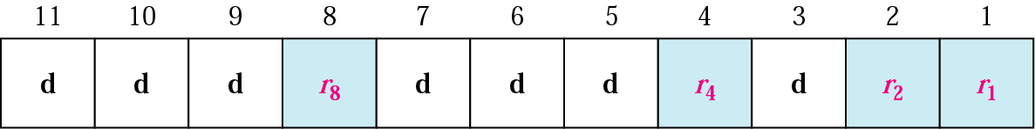
Redundancy Bits Calculation
Parity Bits
Decimal | Binary
3 | 0011
5 | 0101
6 | 0110
7 | 0111
9 | 1001
10 | 1010
11 | 1011
Uses four (4) parity bits
Bit Position 1 (r₁): Bits 3, 5, 7, 9, 11
Bit Position 2 (r₂): Bits 3, 6, 7, 10, 11
Bit Position 4 (r₃): Bits 5, 6, 7
Bit Position 8 (r₄): Bits 9, 10, 11

Slide 12
Redundancy Bits Calculation
Position 1: check 1 bit, skip 1 bit, ..etc. (1,3,5,7,9,11,13,15,...)
Position 2: check 2 bits, skip 2 bits, ..etc. (2,3,6,7,10,11,14,15,...)
Position 4: check 4 bits, skip 4 bits, ..etc. (4,5,6,7,12,13,14,15,20,21,22,23,...)
Position 8: check 8 bits, skip 8 bits..etc. (8-15,24-31,40-47,...)
Position 16: check 16 bits, skip 16 bits, ..etc. (16-31,48-63,80-95,...)

Slide 13
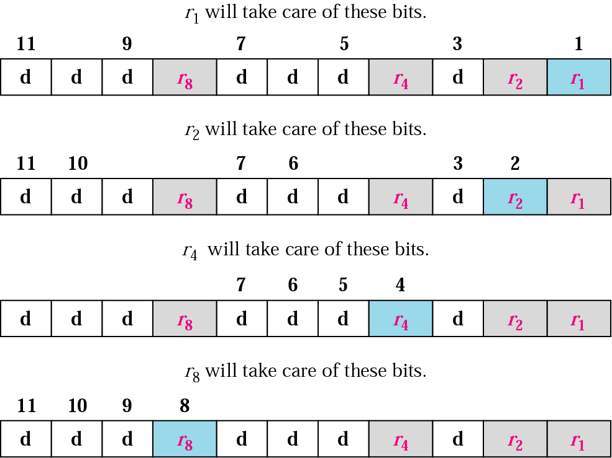
Redundancy Bits Calculation

Slide 14
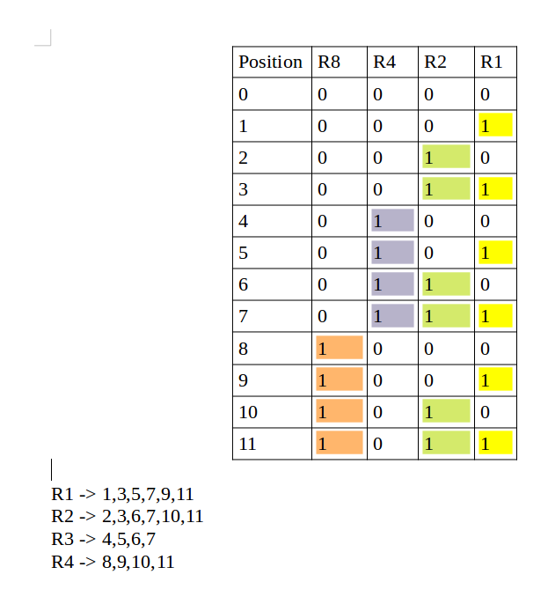
Redundancy Bits Calculation Second Method
Each data bit is included in a unique set of parity bits, as determined its bit position in binary form.
a. Parity bit 1 covers all the bits positions whose binary representation includes a 1 in the least significant position (1, 3, 5, 7, 9, 11, etc).
b. Parity bit 2 covers all the bits positions whose binary representation includes a 1 in the second position from the least significant bit (2, 3, 6, 7, 10, 11, etc).
c. Parity bit 4 covers all the bits positions whose binary representation includes a 1 in the third position from the least significant bit (4–7, 12–15, 20–23, etc).
d. Parity bit 8 covers all the bits positions whose binary representation includes a 1 in the fourth position from the least significant bit bits (8–15, 24–31, 40–47, etc).

Slide 15
Algorithm for calculating hamming code
Encoding a message by Hamming Code
The procedure used by the sender to encode the message encompasses the following steps −
Step 1 − Calculation of the number of redundant bits.
Step 2 − Positioning the redundant bits.
Step 3 − Calculating the values of each redundant bit.
Once the receiver gets an incoming message, it performs recalculations to detect errors and correct them. The steps for recalculation are −
Step 1 − Calculation of the number of redundant bits.
Step 2 − Positioning the redundant bits.
Step 3 − Parity checking.
Step 4 − Error detection and correction

Slide 16
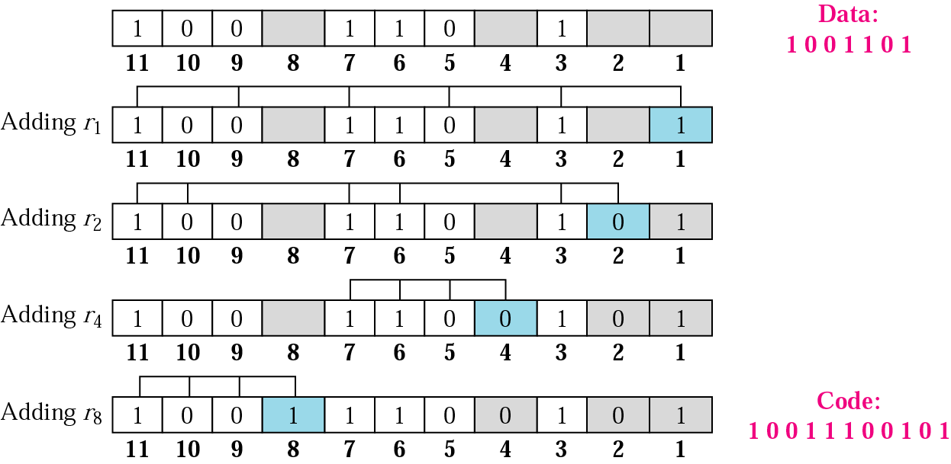
Example
Redundancy bits calculation using even-parity ( at the sender)
So the sender will send 10011100101

Slide 17
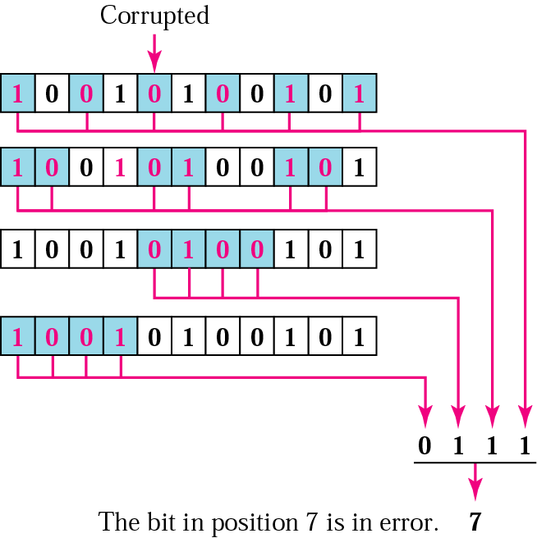
Error Correction using Hamming Code
At the receiver:
So the corrected data will be 10011100101

Slide 18
Frequently Asked Questions
What is error detection and its types
Difference between error detection and error correction
What is Hamming Code.
Discuss redundant bits used in hamming code .
What are the limitations of hamming code

Slide 19
Thank You
Any Questions

